Slide 1

COMS 4995 Project “Dreamhouse”
Eliza Mace
emm2314

Slide 2
Inspiration and Project Goals
Housing market very active due to low interest rates
How can you predict the cost of a house? Using numerical data? Using visual data?
Can we generate a “dream house” given a particular budget range?

Slide 3
Dataset creation
Scrape web with BeautifulSoup for zipcodes of relevant areas
Use python redfin-houses package to retrieve metadata about listings in zipcodes
Use google street view API to retrieve images of homes for sale at the lat/longs specified in the metadata

Slide 4
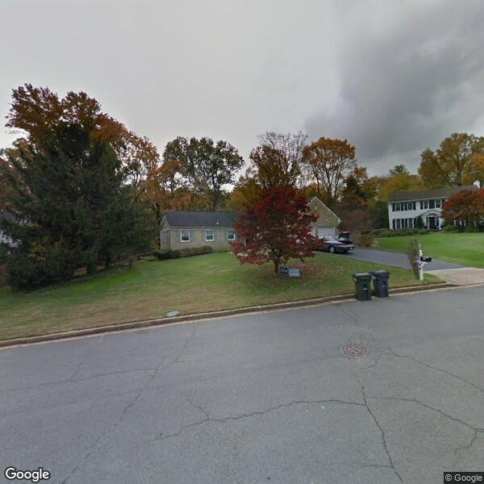
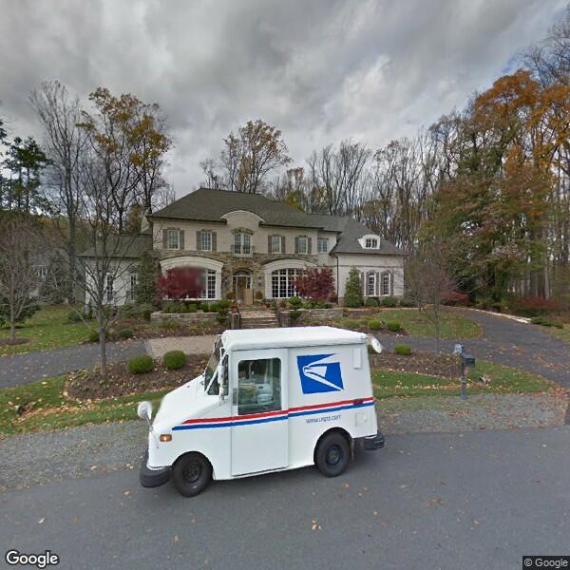
Dataset examples: Desirable
4 bed, 2.5 bath, Built 1971
$975,000
5 bed, 6 bath, Built 2004
$3,500,000

Slide 5
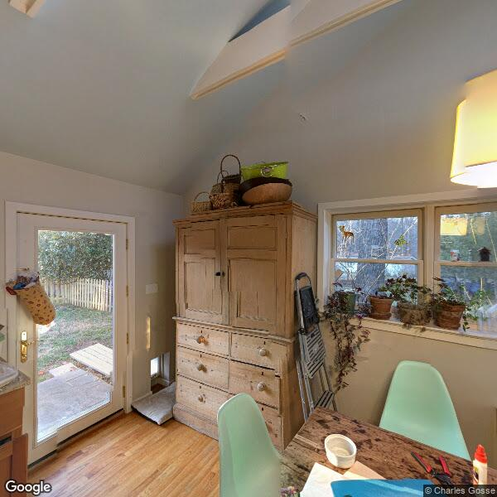
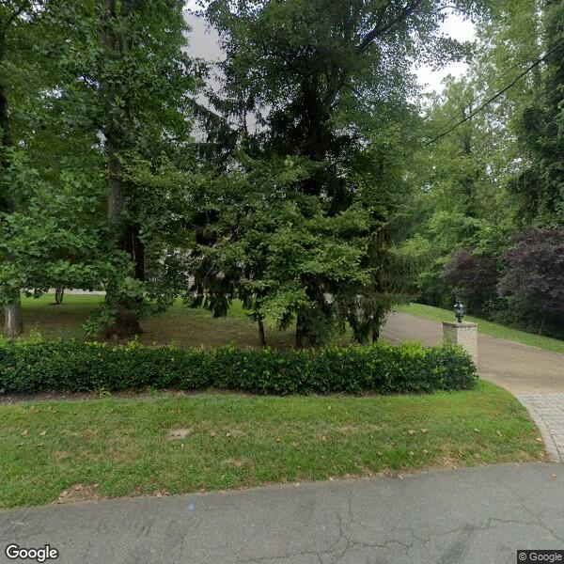
Dataset examples: Undesirable
6 beds, 7 baths, Built 2002
$2,890,000
Discussion:
Tree cover could actually have predictive value:
Mature trees indicate older homes
Increased privacy from neighbors is desirable; could drive price
Future work: mitigation
Use classifier pre-trained on CIFAR-100 (has tree categories)
Remove images that scored highly on tree categories (either automated or sort & suggest to annotator)

Slide 6
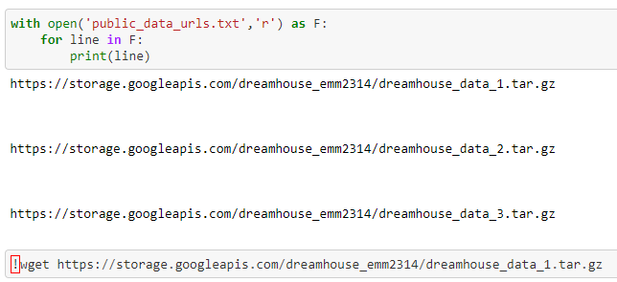
Dataset Summary
Single-family homes for sale in Northern VA in the month of October
1928 600x600 images with annotations
Available for download on google cloud (URLs in Git repo)

Slide 7
Experiments: Numerical models vs. Visual models
Compare 3 numerical models:
Linear model - # bedrooms only
Linear model - # bedrooms, # bathrooms, year built
Model with 1 hidden layer - # bedrooms, # bathrooms, year built
Compare 3 visual models:
Single dense layer
Two convolutional layers + 2 dense layers
Finetuned VGG (base model frozen + 1 trainable dense layer)
N.B. dataset was split so that same train/val/test partition was maintained for numerical data and image data

Slide 8
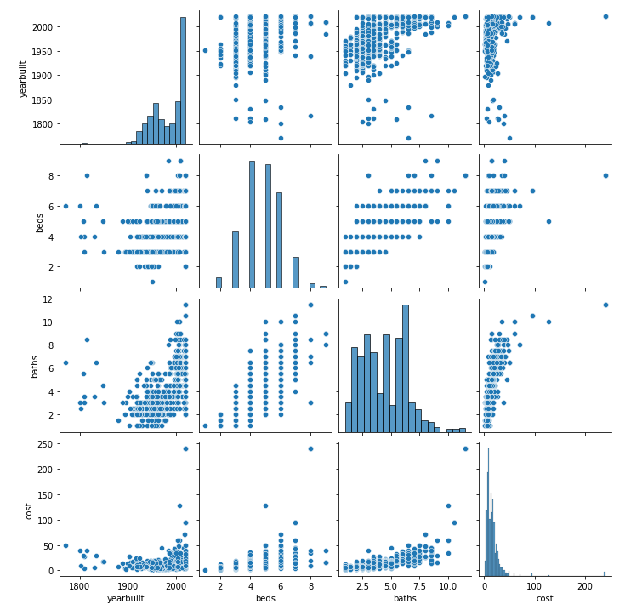
Numerical Models: data exploration
Comparing # beds, # baths, year built, & cost
Stats (note: costs/$100,000)
 | Mean | Std. Dev.
# Bedrooms | 4.79 | 1.27
# Bathrooms | 4.43 | 1.95
Year Built | 1984 | 36.8
Cost | 16.7 | 19.3

Slide 9
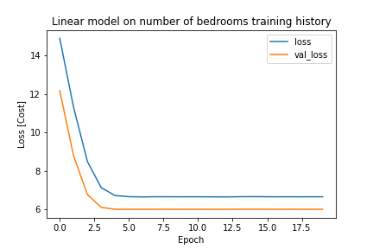
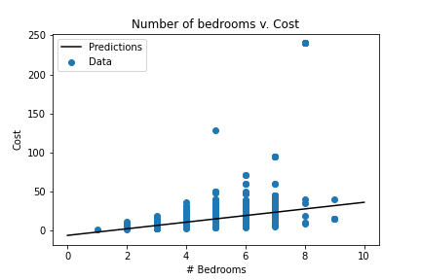
Numerical Models: Linear model, # bedrooms
Training history
*note possible overfitting
Sanity check: linear model predictions

Slide 10
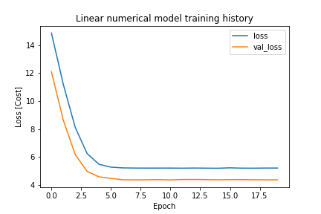
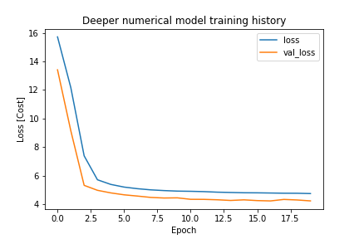
Numerical models: all inputs
Linear model, 3 input variables
1 Hidden layer, 3 input variables

Slide 11
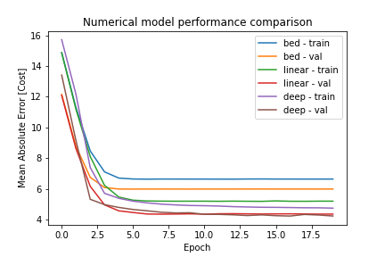
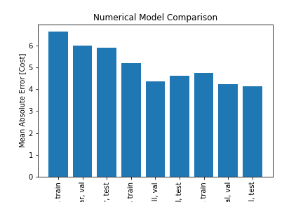
Numerical models: Performance comparison
MAE over training time (train & val)
Final MAE (includes held-out test set)

Slide 12
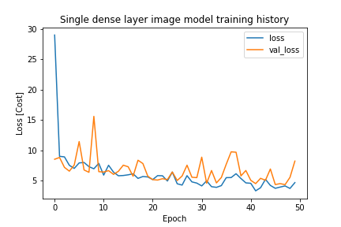
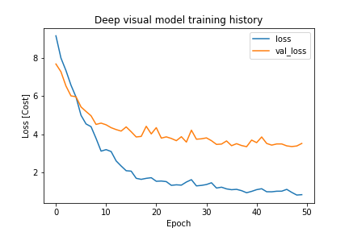
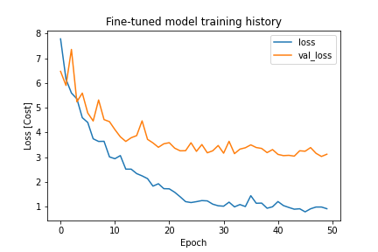
Visual Models: training comparison
N.B. Fewer indicators of overfitting than numerical models during training

Slide 13
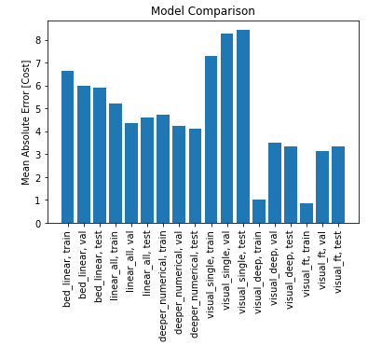
Overall model MAE comparison

Slide 14
Part 2: GANs and c-GANs
Putting the “dream” in “dreamhouse”

Slide 15
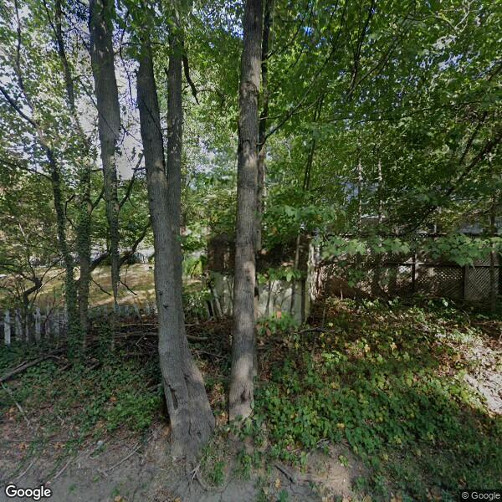
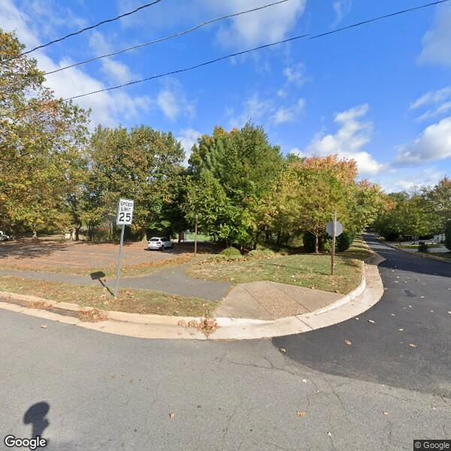
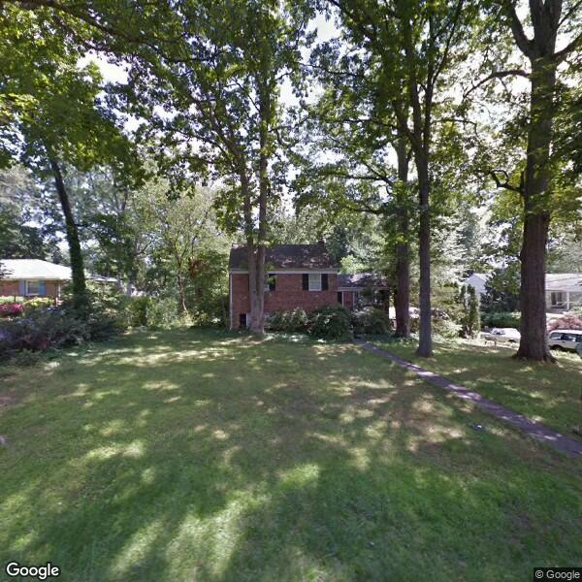
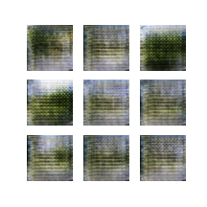
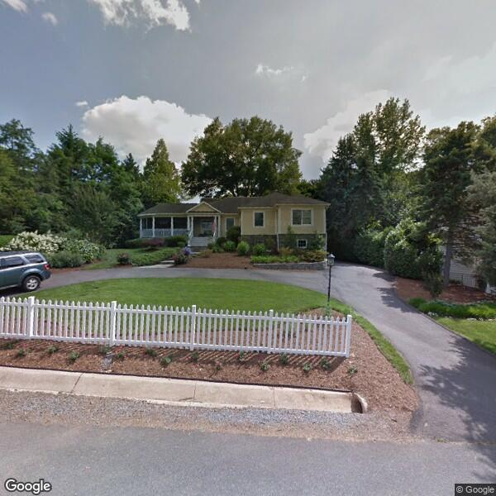

GANs (background)
Generator
Generated images
Training images
Random noise
Discriminator
Class 0 (fake)
Class 1 (real)
Feedback
Prediction

Slide 16
Setup
Followed tensorflow.org’s DCGAN tutorial https://www.tensorflow.org/tutorials/generative/dcgan
Modification: image shape
Original tutorial is on MNIST, which can be well visualized in small size; had to increase depth of network to include more upsampling to get to a larger size for the generator output
MNIST is 1-band (grayscale); had to modify for RGB images
Modification: batch size
Due to larger image sizes, fewer images could fit in memory per batch

Slide 17
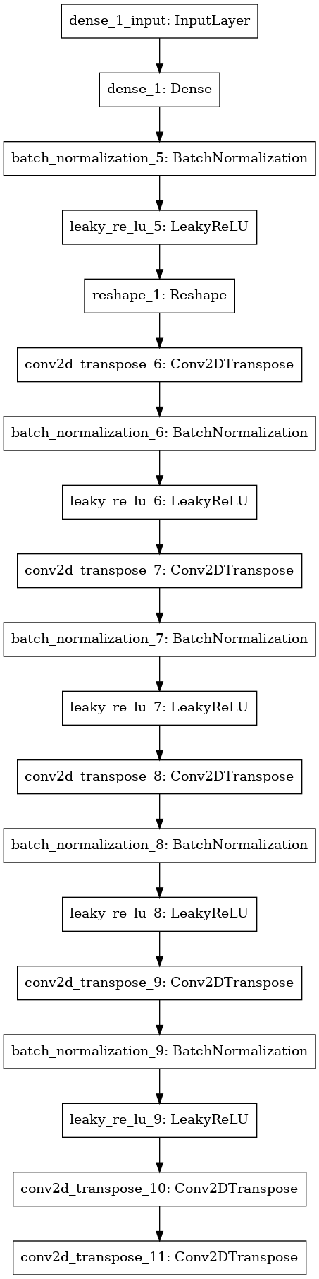
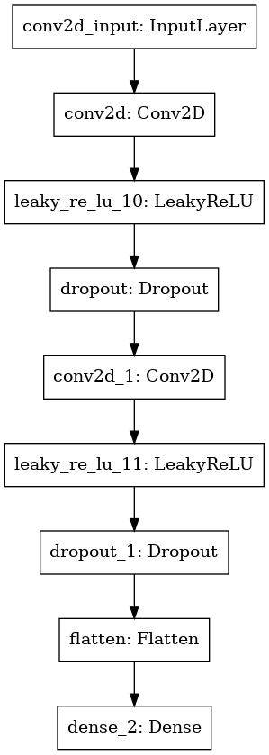
Setup: Model Architecture
Generator
Discriminator

Slide 18
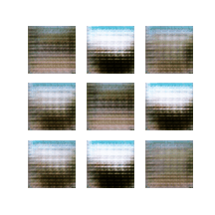
DC-GAN: Attempt 1
Learning rate for both generator and discriminator at 10⁻⁴ (both use Adam optimizer)
Trained for 300 epochs (batch size 64)
Generator seems to have learned general colors, placement of ground/sky, etc.
Noticed generated images “jumping” around drastically visually; hypothesized a lower learning rate would help

Slide 19

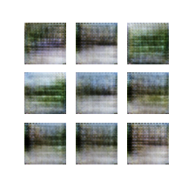
DC-GAN: Attempt 2
Lowered learning rate for both networks to 10^-5
“Smoother” visually between epochs
GAN architecture alone does not fulfill our goal: how to include budget info?

Slide 20
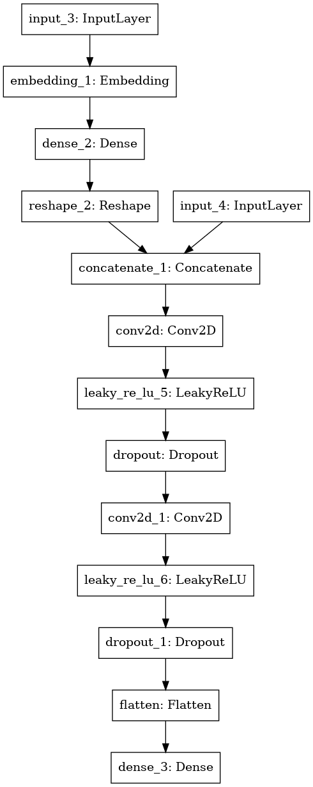
Conditional GANs
c-GAN
Adding classification label to each image (generated image is conditioned on class label) https://arxiv.org/pdf/1411.1784.pdf
Implementation: concatenate label and image layer (help from: https://machinelearningmastery.com/how-to-develop-a-conditional-generative-adversarial-network-from-scratch/)
GAN

Slide 21
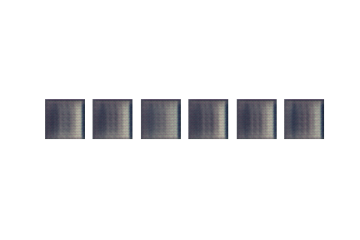
c-GAN Results
Budget | <$600,000 | $600,000 to $1,000,000 | $1,000,000 to $1,400,000 | $1,400,000 to $1,800,000 | $1,800,000 to $2,200,000 | $2,200,000 and above
Your “dream house”!

Slide 22
Code Walkthrough
All code available at https://github.com/emace593/dreamhouse_public
Numerical vs. Visual models
part1.ipynb
DC-GAN
part2.ipynb
c-GAN
part2B.ipynb – my implementation
example_cgan.ipynb – adapted implementation from https://machinelearningmastery.com/how-to-develop-a-conditional-generative-adversarial-network-from-scratch/

Slide 23
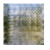

Thank you!
(squint really hard; trust me!)

